Slide 1
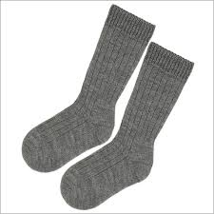
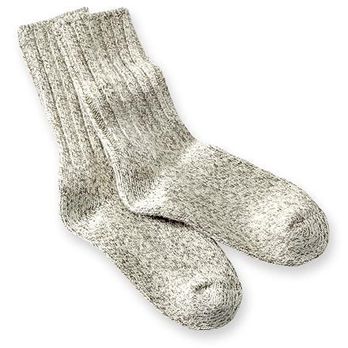
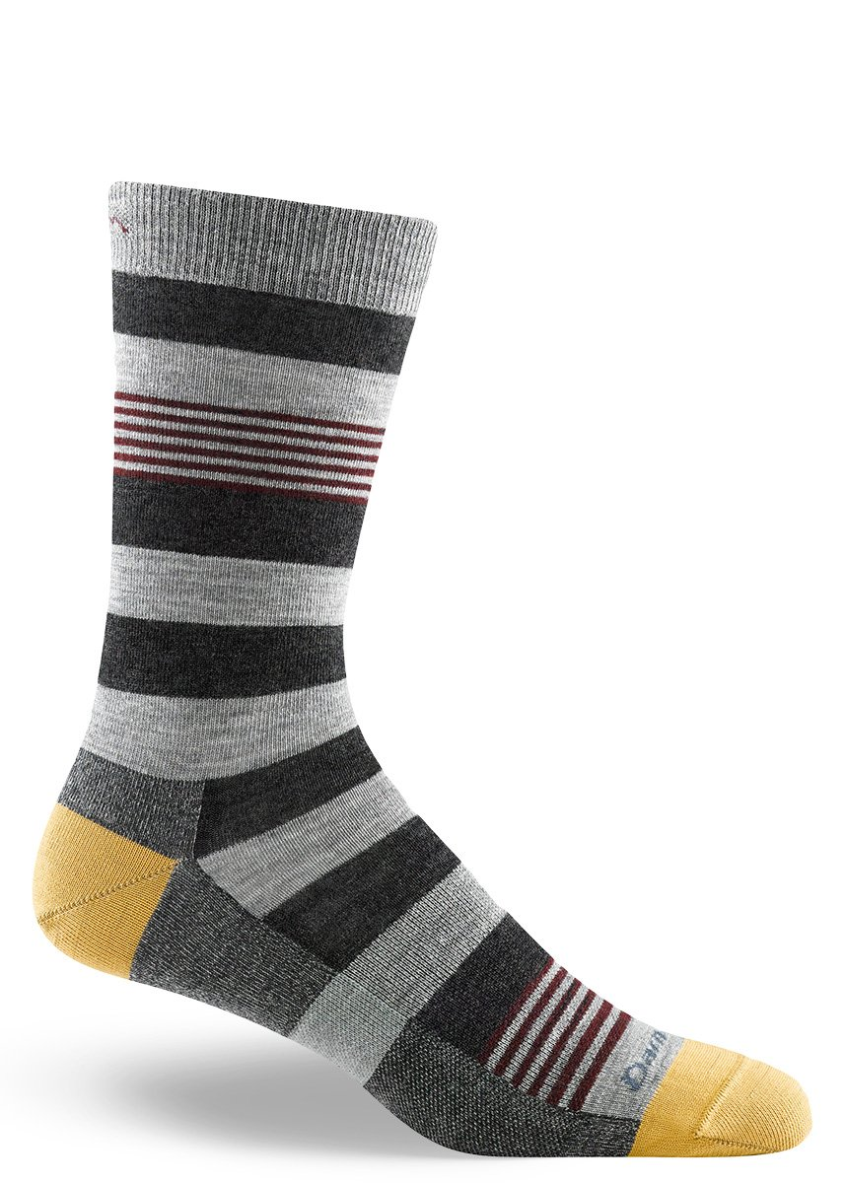
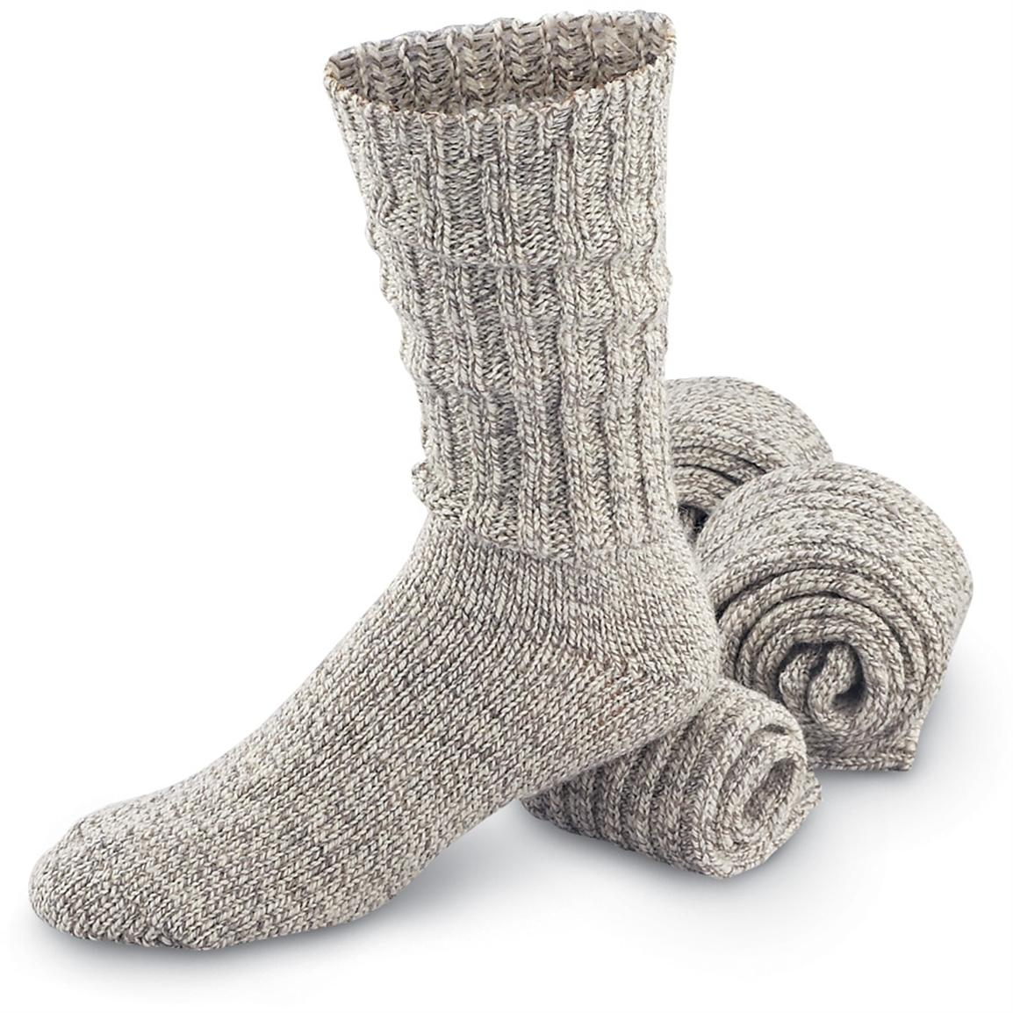
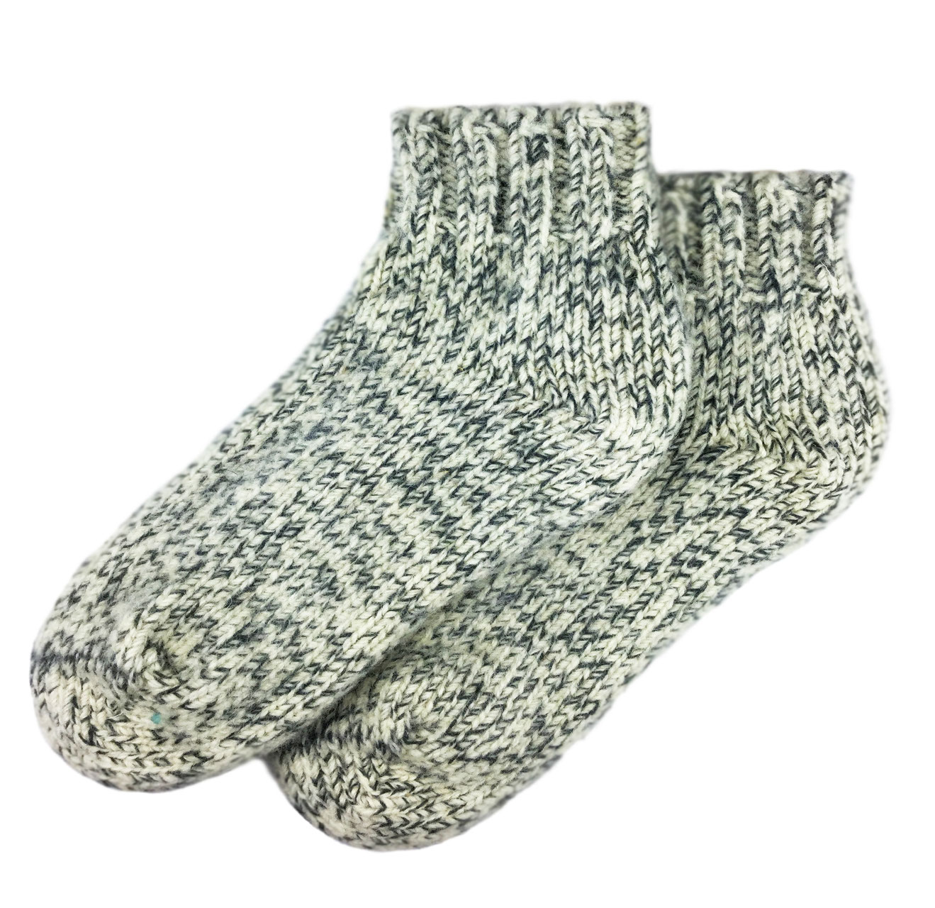
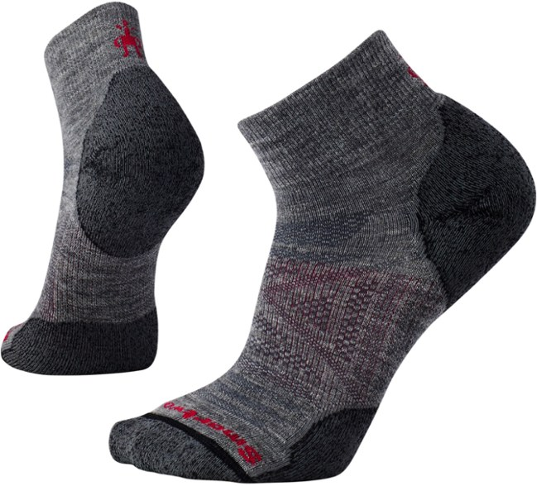
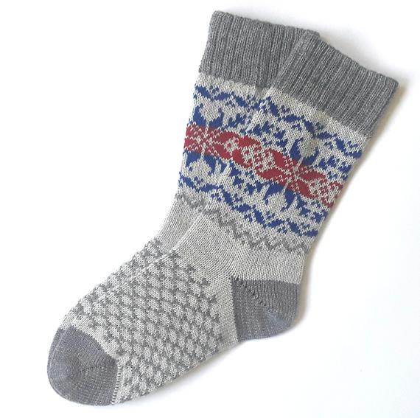
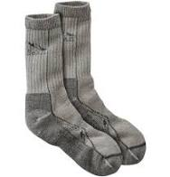


Slide 2







Slide 3






Slide 4






Slide 5








Slide 6
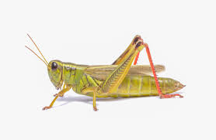
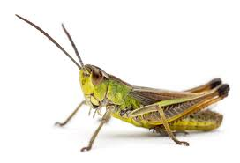
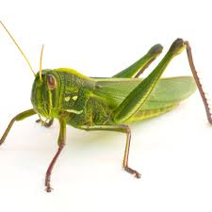
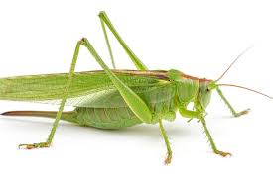


Slide 7

***Please note that I give permission for these materials to be used and/or printed for instructional & educational purposes ONLY. I do not give permission for my materials to be duplicated, copied, or altered in any way for personal gain or re-sale. This product is for individual use only. Please do not claim it as your own or post any part of the materials on a public website. If you would like to share the materials on a public website or presentation, you must gain my PRIOR WRITTEN CONSENT via rollingstreams2019@gmail.com. Thank you!
----------------------------------------------------------------------------------------------------------------------
Graphics Credit: Microsoft PowerPoint & Google Images

